Slide 1
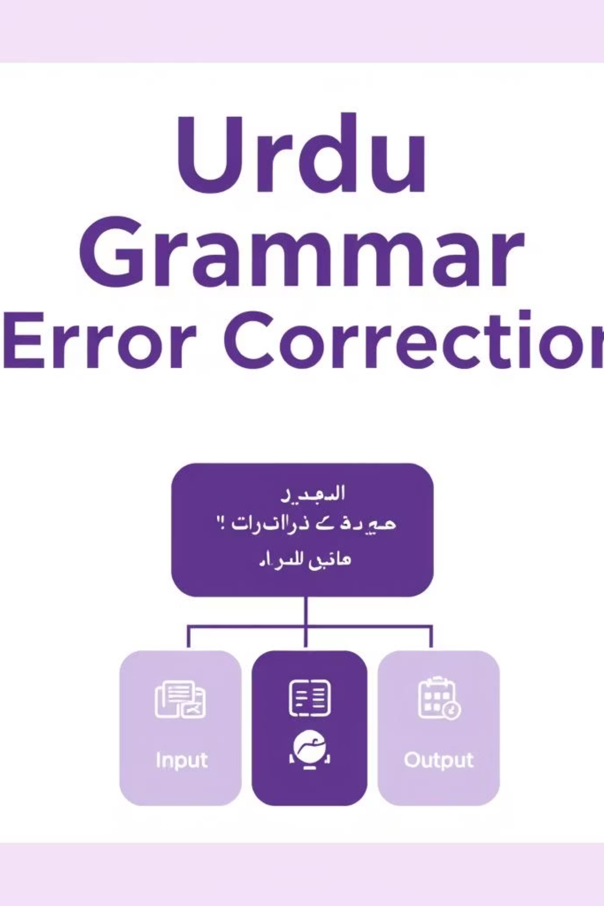
What is Urdu Grammar Error Correction?
Grammar Error Correction (GEC) is a task in Natural Language Processing (NLP) that involves identifying and correcting grammatical mistakes in text.
While English and other major languages have extensive tools and datasets, Urdu GEC remains underexplored.
This project aims to fill that gap using deep learning and transfer learning with the mT5 model.

Slide 2
Why Urdu GEC?
Urdu is spoken by millions but lacks computational tools for grammar assistance.
No public dataset or correction system existed before this for Urdu.
Inspired by success in English and Hindi GEC systems.
Helping students, writers, and learners of Urdu through AI-based grammar assistance.
Building something useful for local language users using modern AI.

Slide 3
What has been done before?
Prior work focused on English, Arabic, and Hindi.
Copy-Augmented Transformers and PIE models showed high precision in English.
(Solyman et al., 2019): Arabic GEC using encoder-decoder + attention.
(Sonawane et al., 2020): Hindi GEC using rule-based errors + Wikipedia edits.
Our work is inspired by these models but adapted specifically for Urdu morphology and syntax.

Slide 4
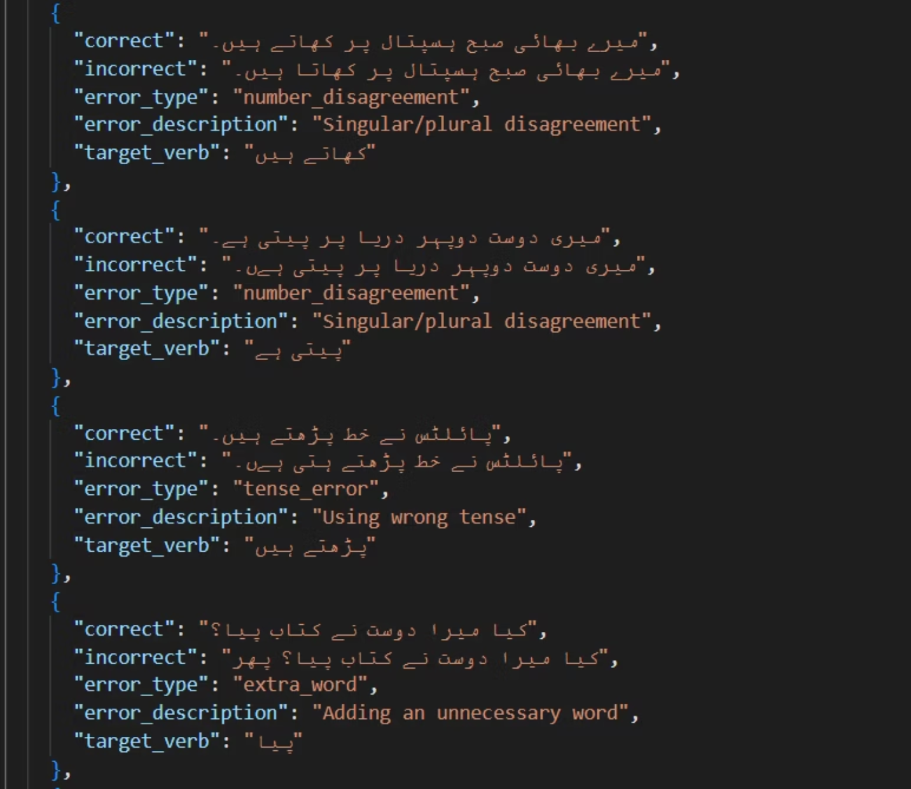
Creating Our Own Dataset
10,000 Urdu sentences collected via scraping (Wikipedia, news).
Used Python scripts to inject 7 error types:
Gender
Tense
Number
Word Order
Spelling
Missing Words
Extra Words
Formatted as JSON: {"incorrect": "...", "correct": "..."}.
Tokenized using MT5Tokenizer.
Masked padding during training (-100), batched with DataLoader.
علی اسکول جاتی ہے
علی اسکول جاتا ہے
وہ کتاب پڑھا
وہ کتاب پڑھی
میں نے کھانا کھایا
میں نے کھانا کھائی

Slide 5
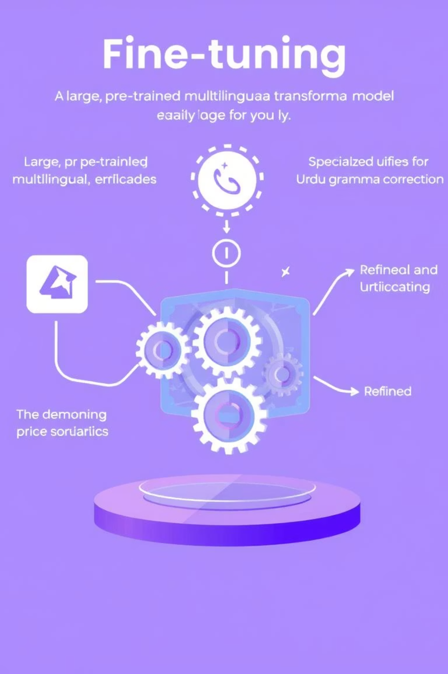
Fine-Tuning mT5 for Urdu
Used google/mt5-small — a pretrained multilingual transformer.
Training settings:
Optimization:
Epochs: 10
Optimizer: AdamW
Batch size: 8
Scheduler: Linear warm-up
Max token length: 128
Loss: Cross-Entropy with padding masked
Environment:
Training on Colab (GPU if available)
Transfer Learning = We used a model that already knows Urdu → fine-tuned it for correction.
We didn’t train from scratch – we fine-tuned a smart model to get smarter on Urdu errors.

Slide 6
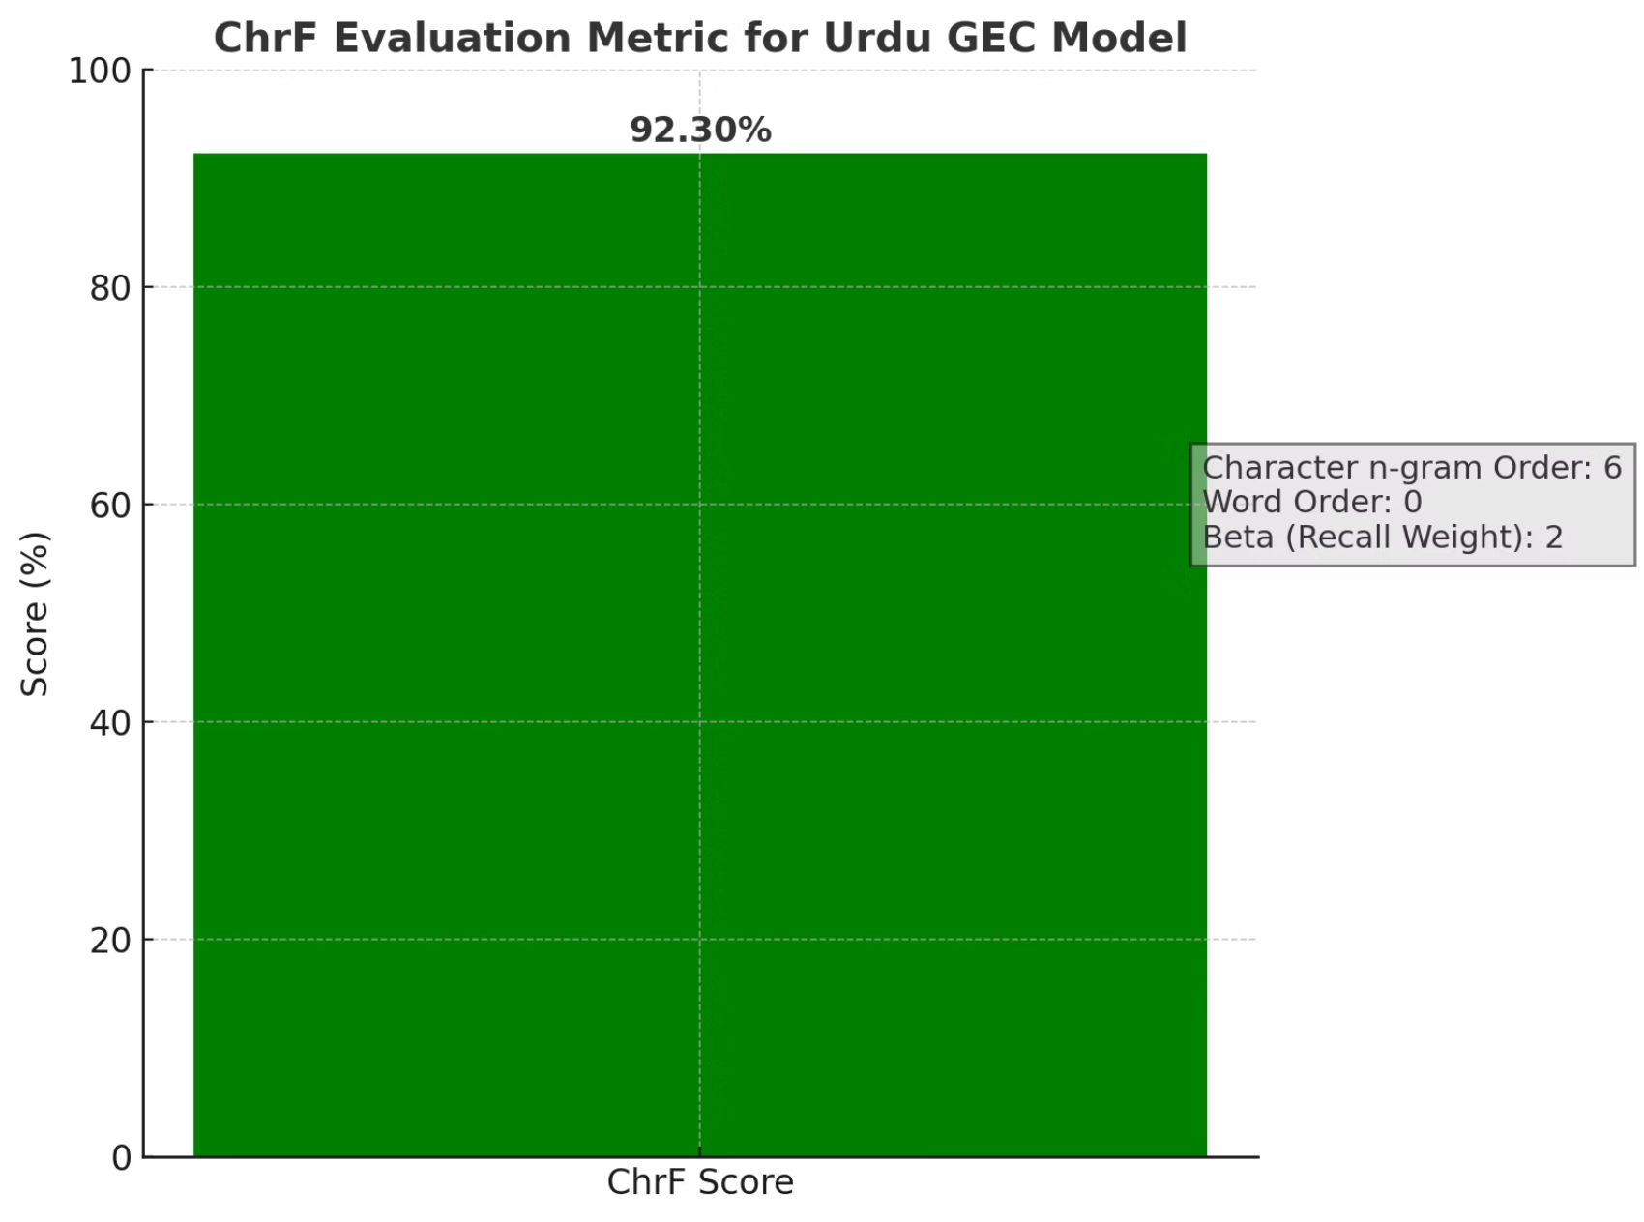
Performance and Evaluation
Metric used: ChrF (Character n-gram F-score)
Final score: 92.30
High character-level similarity with ground truth.
Great for morphologically rich languages like Urdu.
Model successfully:
Corrected gender/verb mismatches.
Left already-correct sentences unchanged.
Examples:
❌ استاد نے کمپیوٹر خریدا۔ → ✅ استاد نے کمپیوٹرخریدی ۔
✅ کیا بلی نے کتاب کھیلی؟ → No correction needed.

Slide 7




What We Couldn't Do — Yet!
No public dataset
Artificial errors ≠ Real-world mistakes.
We had to create one manually.
Only simple inflectional errors were handled.
Short/simple sentences (scraped from children’s stories) used.
Future:
Collect naturally occurring errors.
Handle complex, multi-error sentences.
Use mT5-base or mT5-large for better performance.
Better hardware = bigger models.

Slide 8
Summary & Takeaways
First complete neural Urdu GEC pipeline using mT5.
Created a working dataset and model from scratch.
Achieved ChrF score of 92.30 — high quality correction.
Lays the foundation for future Urdu NLP projects.
GEC in Urdu is no longer unexplored — this is a starting point.

